Slide 1
Understanding Data bindings
Hardeep Kaur Dhalla

Slide 2
Objectives
String Interpolation binding
Data binding basics

Slide 3
Angular components
A component controls a patch of screen called a view.
You define a component's application logic—what it does to support the view—inside a class.
The class interacts with the view through an API of properties and methods.
Angular creates, updates, and destroys components as the user moves through the application.

Slide 4
Templates and views
In Angular, a template is a chunk of HTML.
When you generate an Angular application with the Angular CLI, the app.component.html file is the default template containing placeholder HTML.
Views are typically arranged hierarchically
The template immediately associated with a component defines that component's host view.

Slide 5
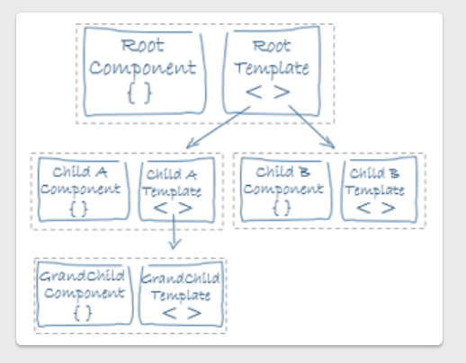
Templates and views
A component class and its associated template define a view.

Slide 6
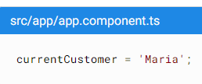
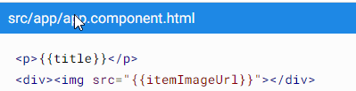
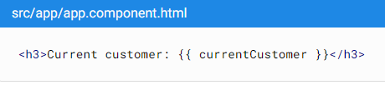
Text/String interpolation binding
Text interpolation lets you incorporate dynamic string values into your HTML templates.
By default, interpolation uses the double curly braces {{ and }} as delimiters.

Slide 7
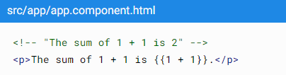
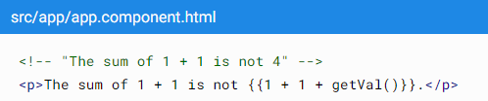
Template expression
With interpolation, Angular performs the following tasks:
Evaluates all expressions in double curly braces.
Converts the expression results to strings.
Links the results to any adjacent literal strings.
Assigns the composite to an element or directive property.

Slide 8
Data binding
Data binding automatically keeps your page up-to-date based on your application's state.

Slide 9
Types of data binding
Angular provides three categories of data binding according to the direction of data flow:
From the source to view
From view to source
In a two-way sequence of view to source to view

Slide 10
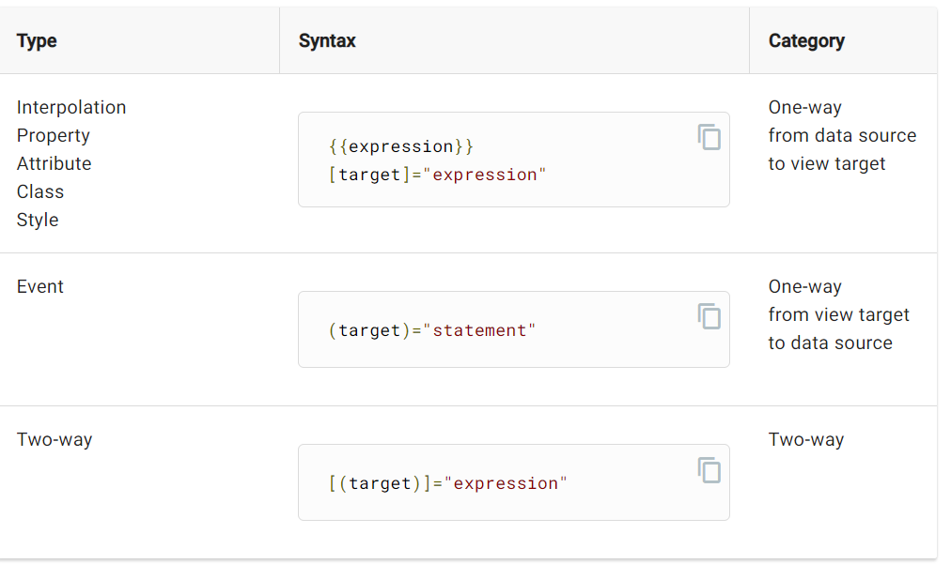

Slide 11
Binding punctuation
The binding punctuation of [], (), [()], and the prefix specify the direction of data flow.
Use [] to bind from source to view.
Use () to bind from view to source.
Use [()] to bind in a two-way sequence of view to source to view.
Place the expression or statement to the right of the equal sign within double quotes, ""

Slide 12
Data binding
Expression
<div [ngClass] = “getClasses()”>
The brackets, [], cause Angular to evaluate the right-hand side of the assignment as a dynamic expression.
Without the brackets, Angular treats the right-hand side as a string literal and sets the property to that static value.
Target specifies what the binding will do. Two types: a directive or a property Binding.
Host element
Target

Slide 13
Directives
Directives are classes that add additional behavior to html elements in your Angular applications.
There are built-in directives available in angular, but you can also create your own directives.
Using them we can modify the appearance or content or behavior of HTML elements.
ngClass is also an example of an in-built directive. There are more such as ngStyle, ngIf, ngFor etc.

Slide 14
Property bindings
[property]
<input [value] = “getProduct(1)?.name || ‘None’”>
[attr.name]
<td [attr.colspan] = “getProducts().length”>
[class.name]
<div [class.special]="isSpecial">Special</div>
[style.name]
<button [style.color]="isSpecial ? 'red' : 'green'">

Slide 15
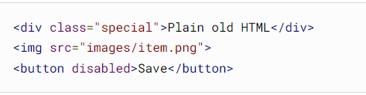
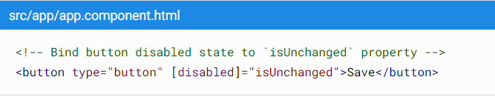
Standard property binding
Developers can customize HTML by specifying attributes with string values.
Using Data binding, we can write dynamic code to control things like the state of a button

Slide 16
Attribute bindings
For using this property, we must first understand DOM(document object model) which is used to represent HTML elements in the browsers.
Not all HTML element attributes have equivalent properties in the DOM API.
Check more here https://developer.mozilla.org/en-US/docs/Web/Api

Slide 17
Attribute bindings
Angular binding distinguishes between HTML attributes and DOM properties.
Remember that HTML attributes and DOM properties are different things, even when they have the same name.
Example: colspan property of td element
<td [attr.colspan] = “getProducts().length”>

Slide 18
Class bindings
There are 3 different ways
<div [class]=“expr”></div>
used to replace any existing classes
Expression gives a string – class names space separated
Note: In latest versions, this can also work with string, array and objects just like ngClass. You can set multiple classes.
<div [class.myClass] = “expr”></div>
uses result to set/add to (not replace) the element’s membership of myClass (for an Individual class)
<div [ngClass] = “expr”></div>
sets class memberships of multiple classes.

Slide 19
Style bindings
There are 3 different ways
<div [style.myStyle]=“expr”></div>
used to set a single style property
<div [style.myStyle.units] = “expr”></div>
uses result to set units for the style value
<div [ngStyle] = “expr”></div>
sets multiple style properties.

Slide 20
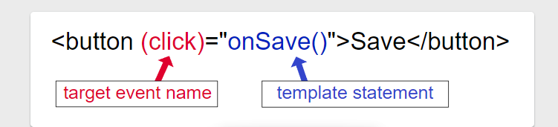
Event Binding
Data flows in one direction from view to source.
Event binding lets you listen for and respond to user actions such as keystrokes, mouse movements, clicks, and touches.

Slide 21
References
https://angular.io/guide/understanding-angular-overview
Attribute, class, and style bindings
https://angular.io/guide/attribute-binding
https://angular.io/guide/property-binding
https://angular.io/guide/property-binding-best-practices

